Slide 1
Chapter 13: I/O Systems
June, 2024
Notes:
a

Slide 2
Chapter 13: I/O Systems
I/O Hardware
Three Ways of I/O
I/O Layers
Application I/O Interface
Kernel I/O Subsystem
Disk, Keyboard, Monitor

Slide 3
I/O Hardware

Slide 4
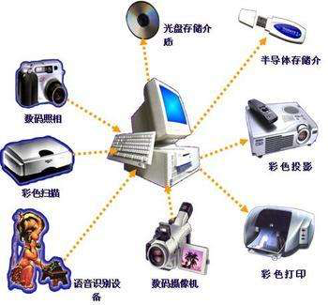
I/O Hardware
Incredible variety of I/O devices
Storage
Transmission
Human-interface

Slide 5
I/O Hardware
Common concepts – signals from I/O devices interface with computer
Bus
PCI bus common in PCs and servers, PCI Express (PCIe)
expansion bus connects relatively slow devices
Controller– electronics that operate port, bus, device
Sometimes integrated
Contains processor, microcode, private memory, bus controller, etc

Slide 6
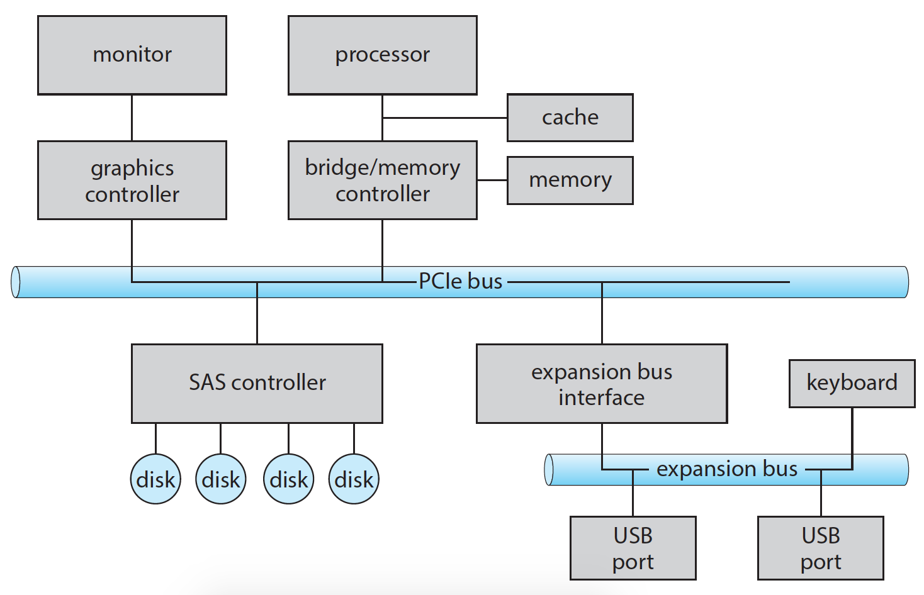
A Typical PC Bus Structure

Slide 7
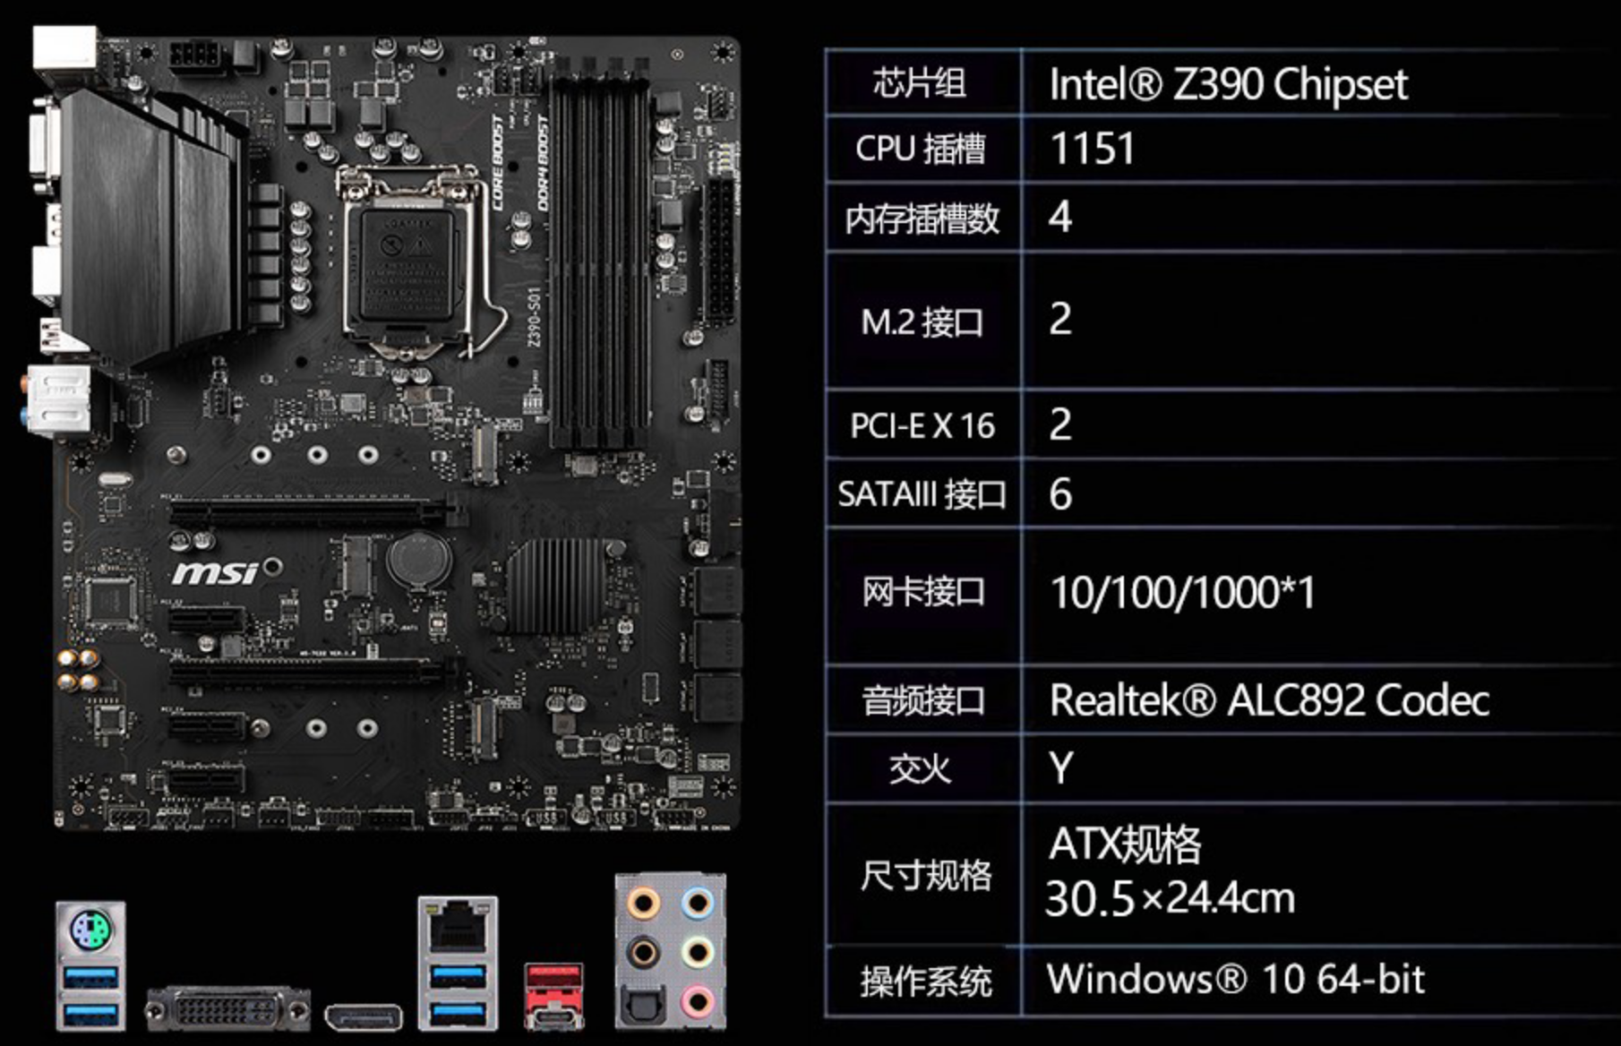
Motherboard

Slide 8
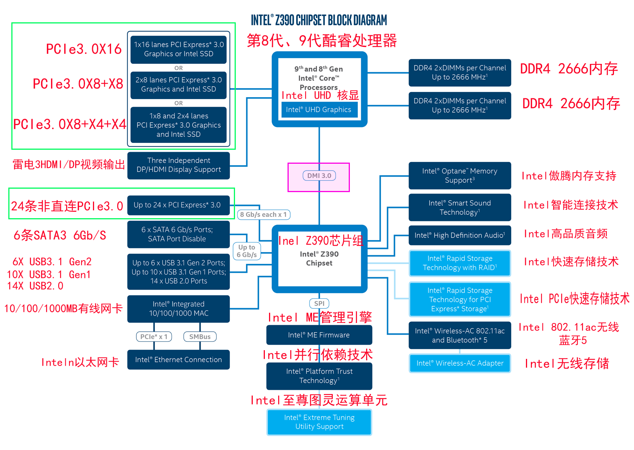
Motherboard Chipset

Slide 9
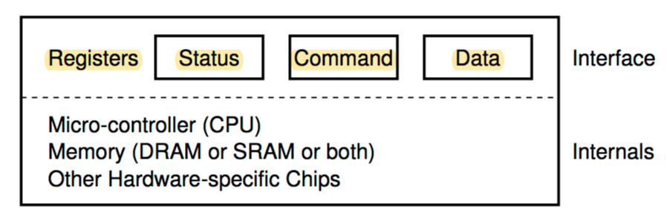
I/O Hardware (Cont.)
Device and device controller
data-in register
data-out register
status register
control register

Slide 10
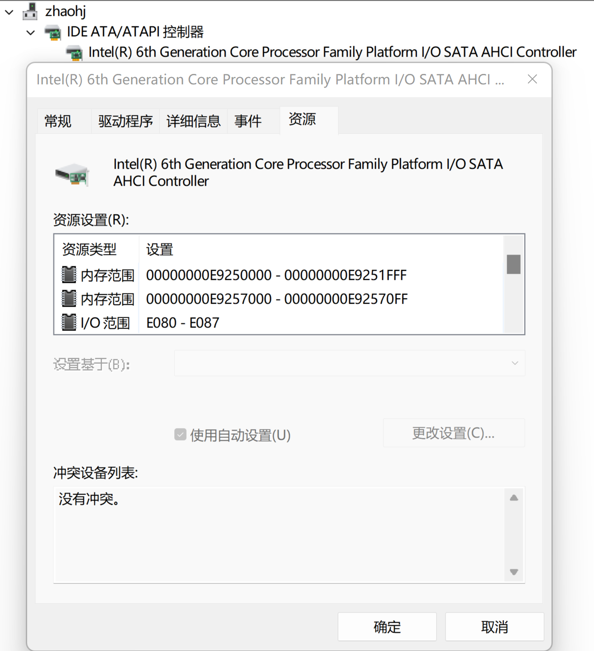
Demo

Slide 11
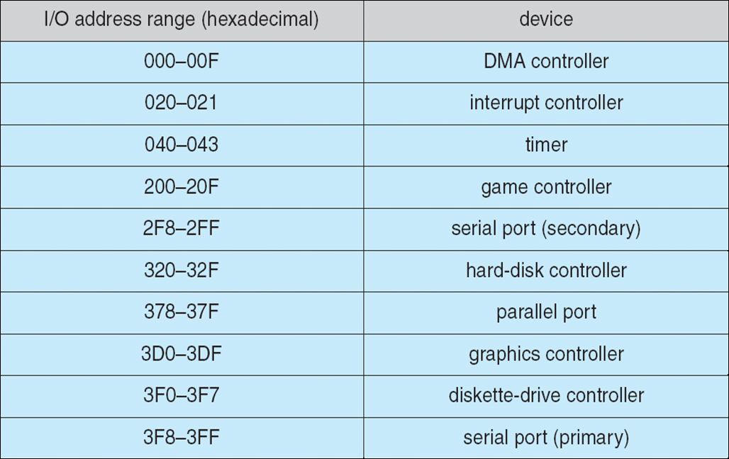
Device I/O Port Locations on PCs (partial)
Notes:
in/out 指令的用法？
Register&memory是统一址的吗？

Slide 12
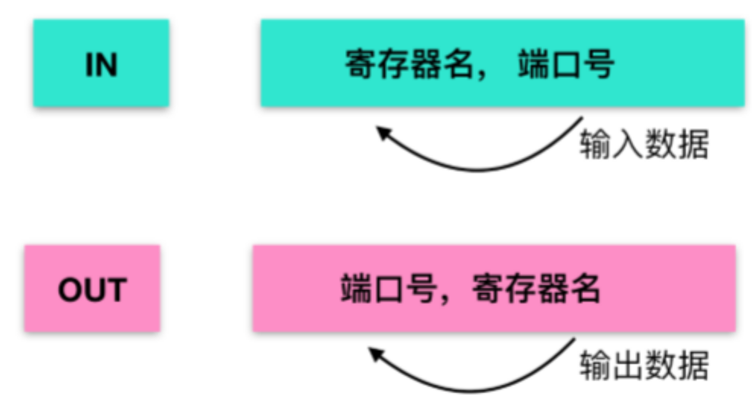
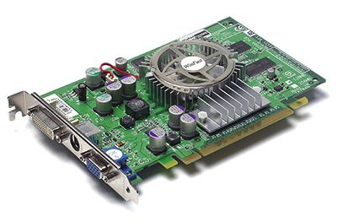
I/O Hardware (Cont.)
Devices have addresses, used by
Direct I/O instructions
in al 60h
out 1f2h al
Memory-mapped I/O
Device memory mapped to processor address space
Especially for large address spaces (graphics)

Slide 13
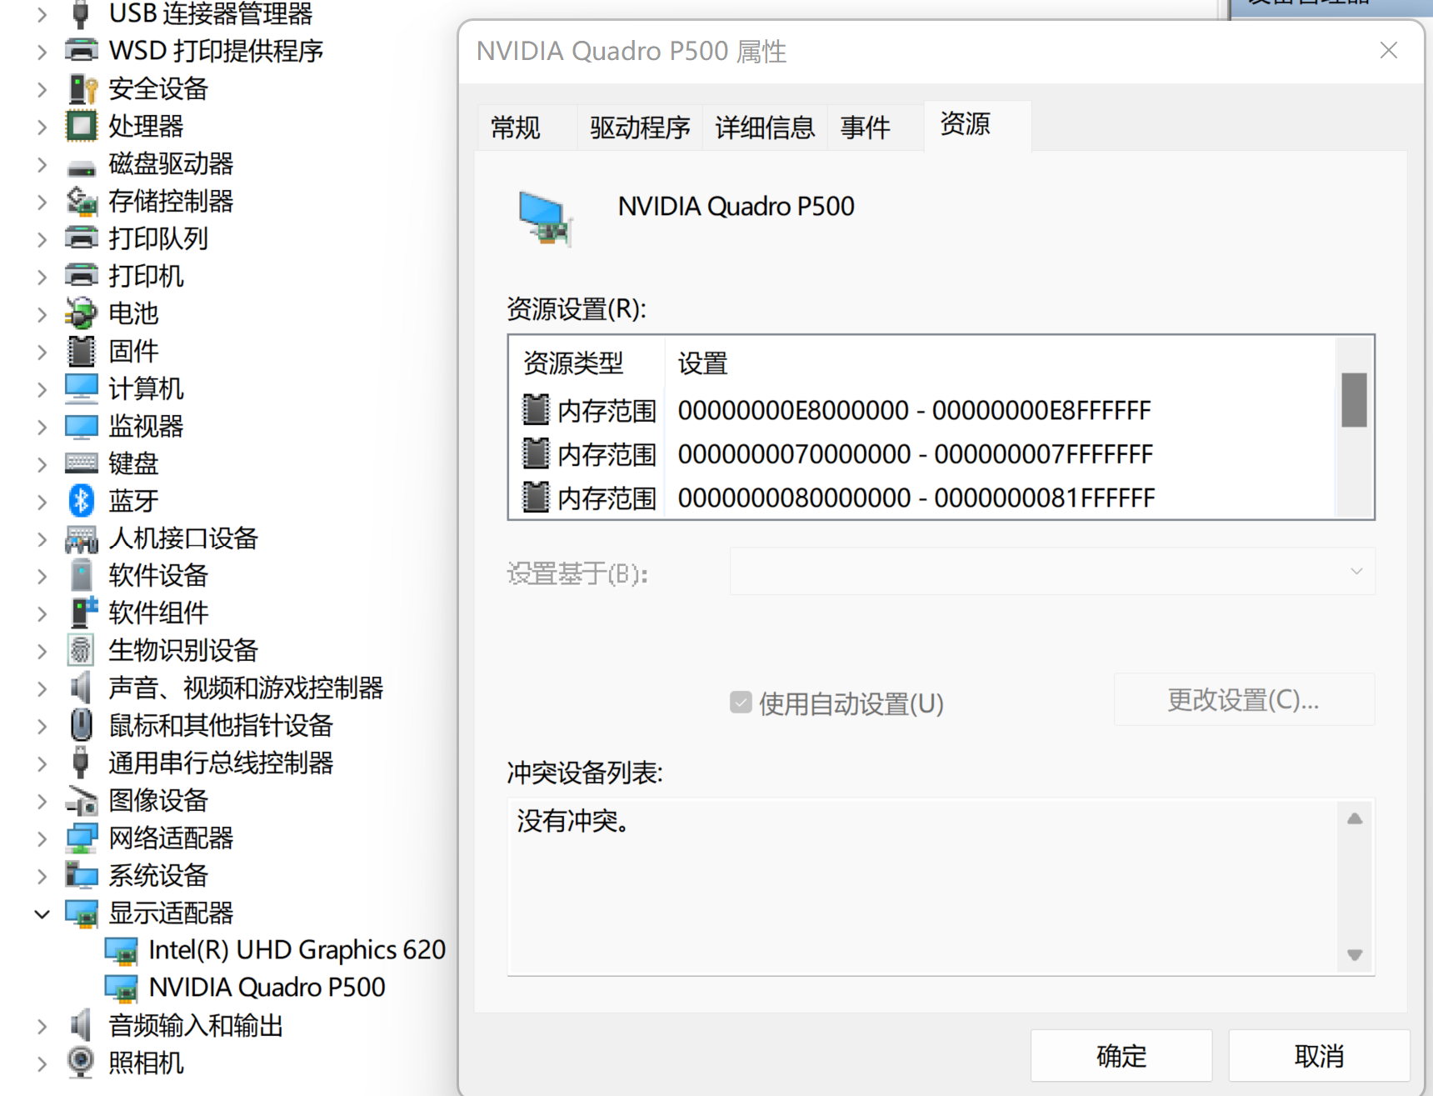
Demo

Slide 14
Three Ways of IO

Slide 15
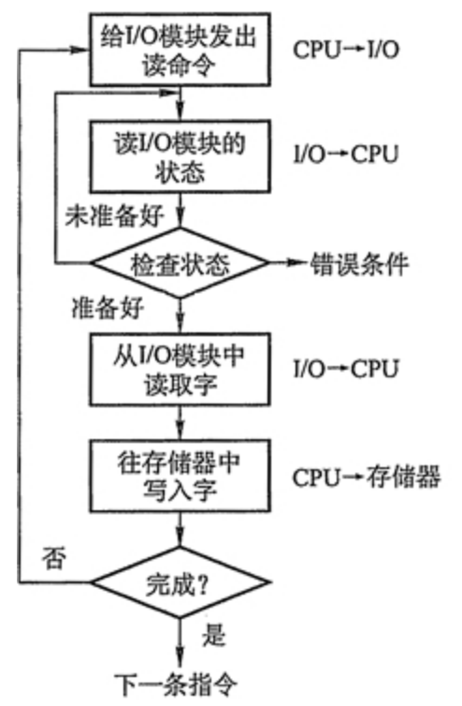
Polling
read

Slide 16
Polling
Interaction between the host and a controller
The host repeatedly reads the busy bit in the status register until that bit becomes clear.
The host sets the write bit in the command register and writes a byte into the data-out register.
The host sets the command-ready bit in the command register.
When the controller notices that the command-ready bit is set, it sets the busy bit.
The controller reads the command register and sees the write command. It reads the data-out register to get the byte and does the I/O to the device.
The controller clears the command-ready bit, clears the error bit in the status register to indicate that the device I/O succeeded, and clears the busy bit to indicate that it is finished.
Notes:
Hard disk

Slide 17
Polling
Interaction between the host and a controller
The host repeatedly reads the busy bit until that bit becomes clear.
The host sets the write bit in the command register and writes a byte into the data-out register.
The host sets the command-ready bit in the command register.
When the controller notices that the command-ready bit is set, it sets the busy bit.
The controller reads the command register and sees the write command. It reads the data-out register to get the byte and does the I/O to the device.
The controller clears the command-ready bit, clears the error bit in the status register to indicate that the device I/O succeeded, and clears the busy bit to indicate that it is finished.
Step 1 is busy-wait cycle to wait for I/O from device
Reasonable if device is fast
But inefficient if device slow
Notes:
Hard disk

Slide 18
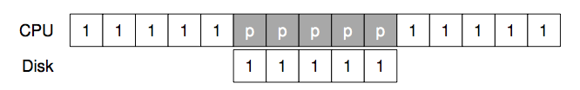
Polling (Programmed IO)

Slide 19
Interrupts
CPU Interrupt-request line triggered by I/O device
Checked by processor after each instruction
Interrupt handler receives interrupts
Maskable to ignore or delay some interrupts
Interrupt vector to dispatch interrupt to correct handler
Context switch at start and end
Based on priority
Some nonmaskable

Slide 20
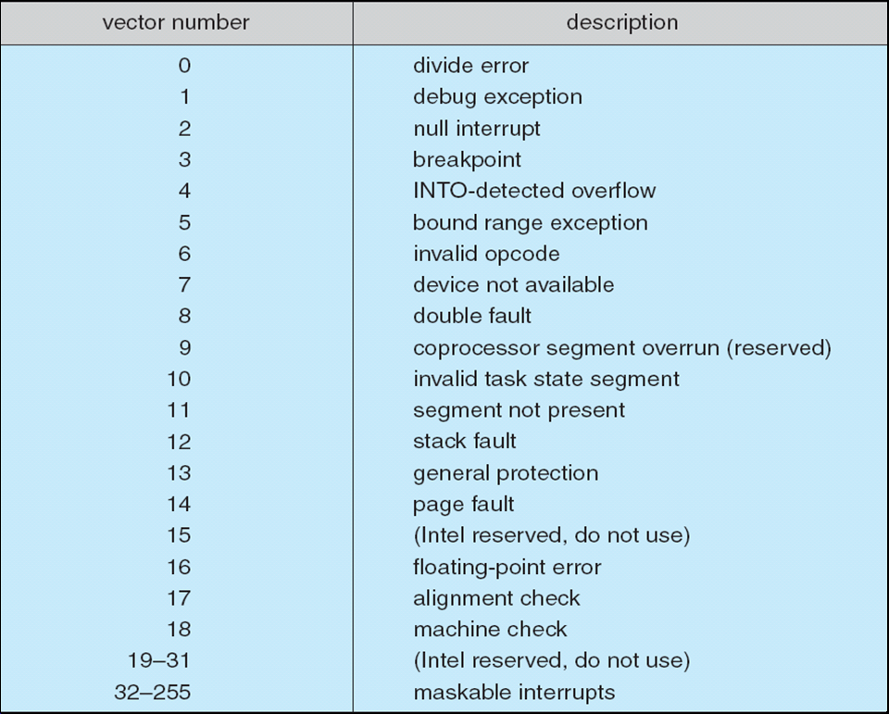
Intel Pentium Processor Event-Vector Table
Notes:
中断次数演示
latency on MacOS

Slide 21
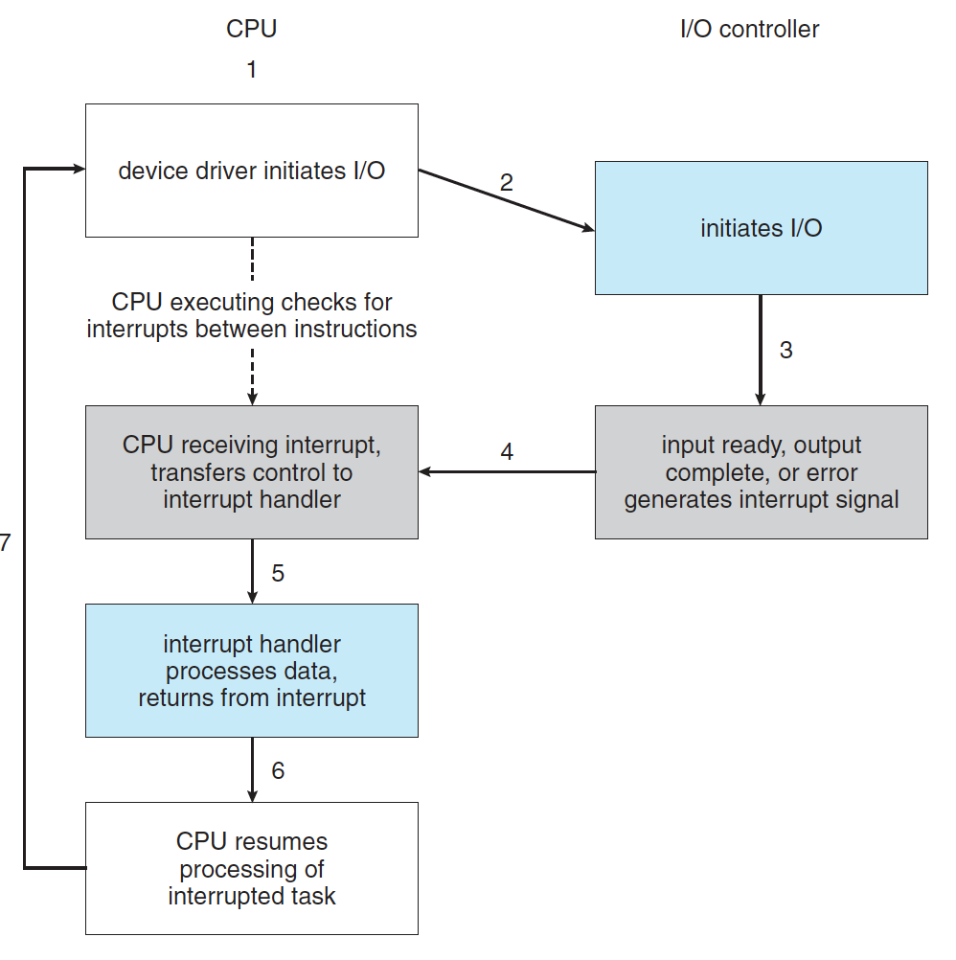
Interrupt-Driven I/O Cycle

Slide 22
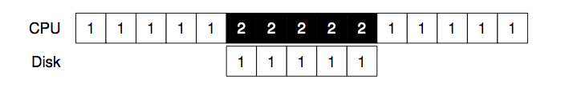
Interrupt

Slide 23
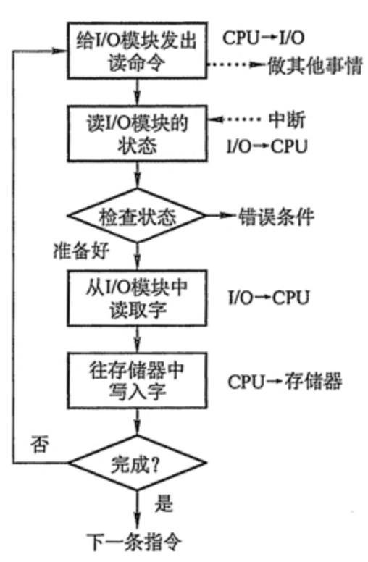
Interrupt
READ

Slide 24
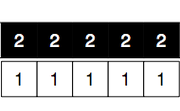
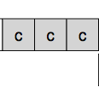
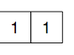
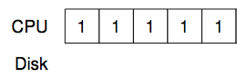
Direct Memory Access
Used to avoid programmed I/O (one byte at a time) for large data movement
Requires DMA controller
Bypasses CPU to transfer data directly between I/O device and memory
Notes:
A picture here

Slide 25
Direct Memory Access
OS writes DMA command block into memory
Source and destination addresses
Read or write mode
Count of bytes
Writes location of command block to DMA controller
Bus mastering of DMA controller – grabs bus from CPU
Cycle stealing from CPU but still much more efficient
When done, interrupts to signal completion

Slide 26
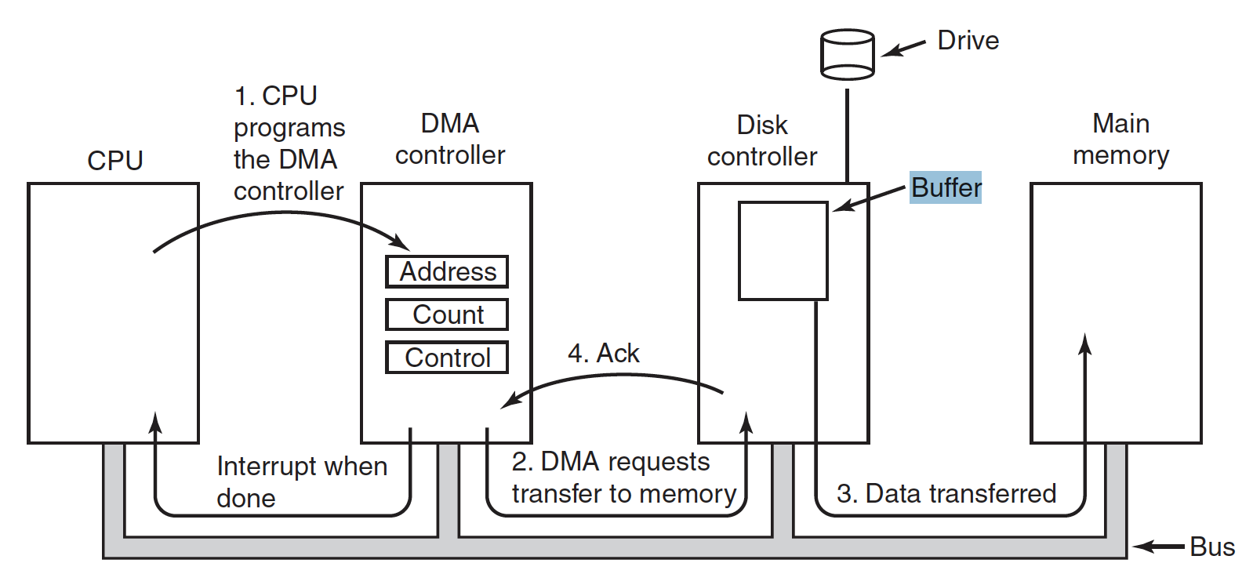
Direct Memory Access
5
Notes:
A picture here (具体步骤需要完善)

Slide 27
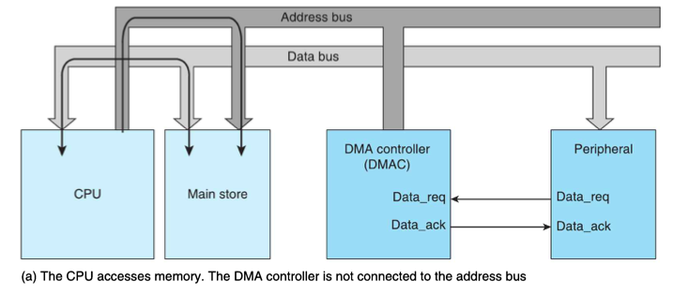
CPU Access Memory
Notes:
(具体步骤需要完善)

Slide 28
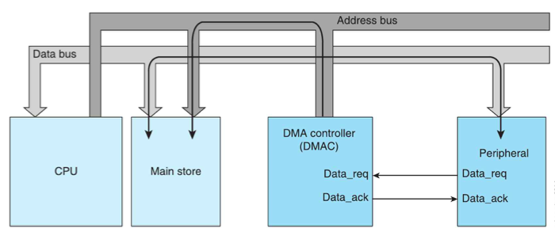
DMA
Notes:
dma提供地址
(具体步骤需要完善)

Slide 29
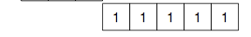
DMA
Disk
DMA

Slide 30
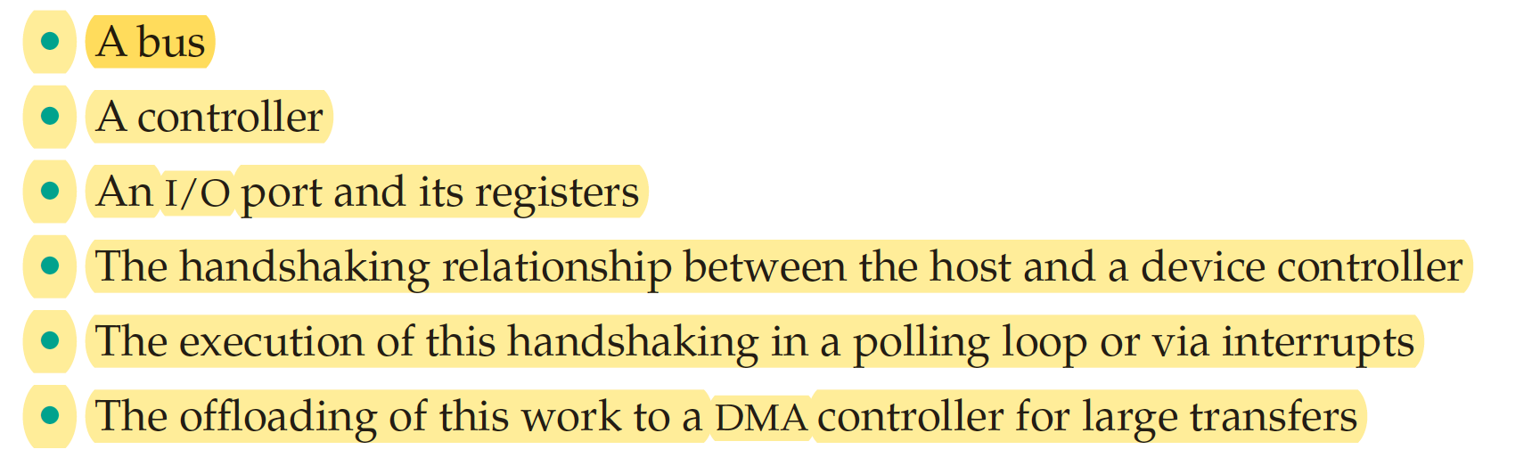
I/O Hardware Summay

Slide 31
I/O Layers

Slide 32
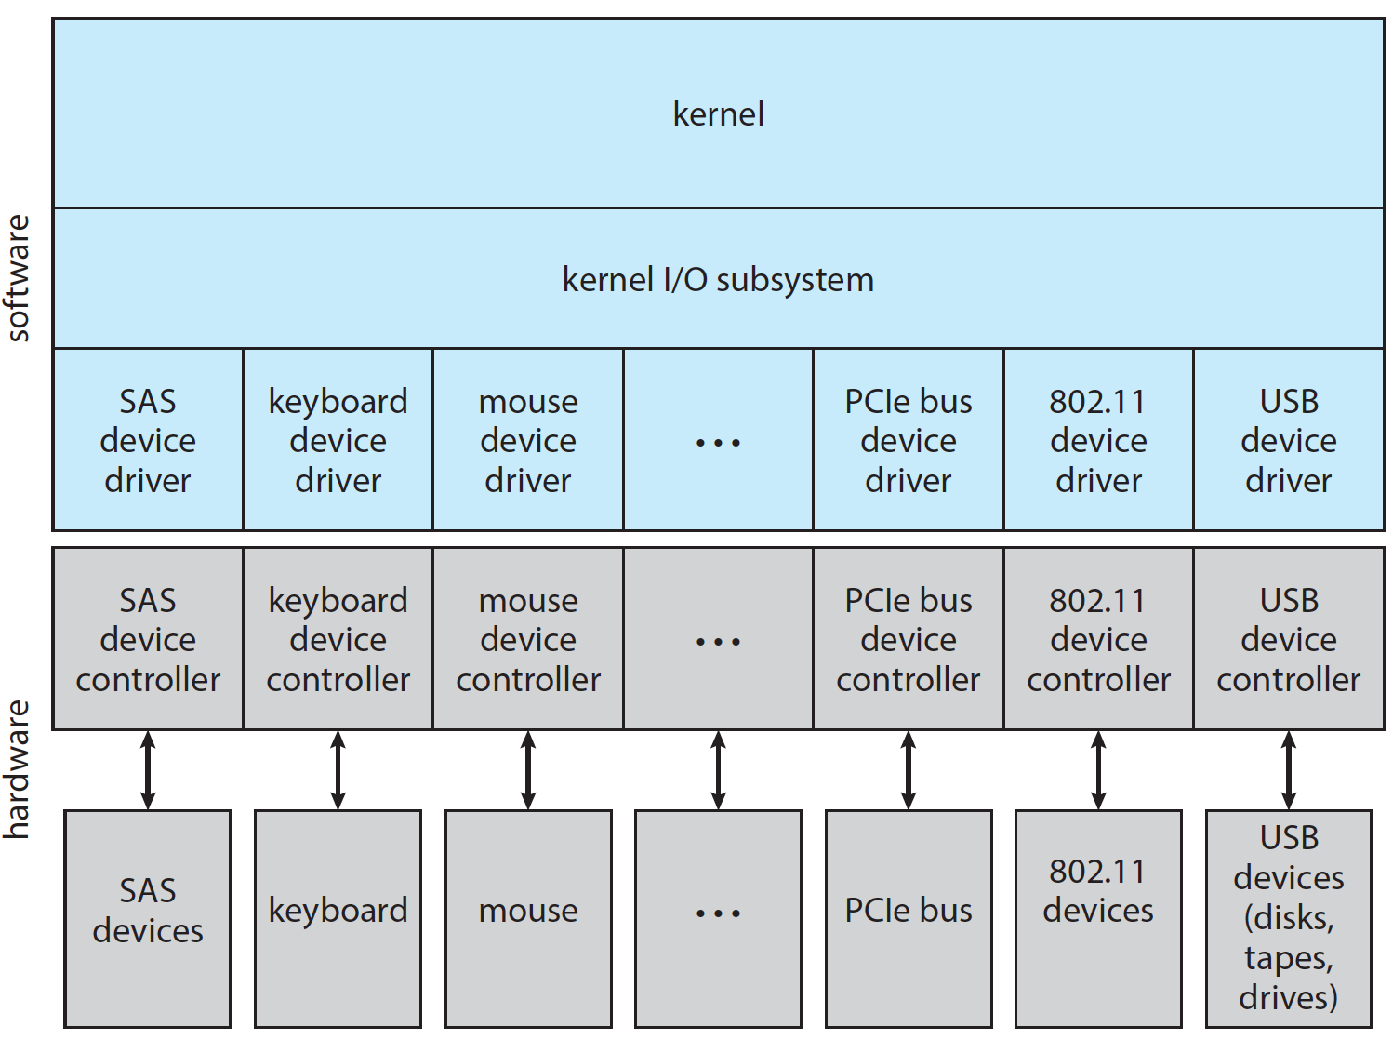
I/O Layers

Slide 33
Characteristics of I/O Devices
Devices vary in many dimensions
Character-stream or block
Sequential or random-access
Synchronous or asynchronous (or both)
Sharable or dedicated
Speed of operation
read-write, read only, or write only

Slide 34
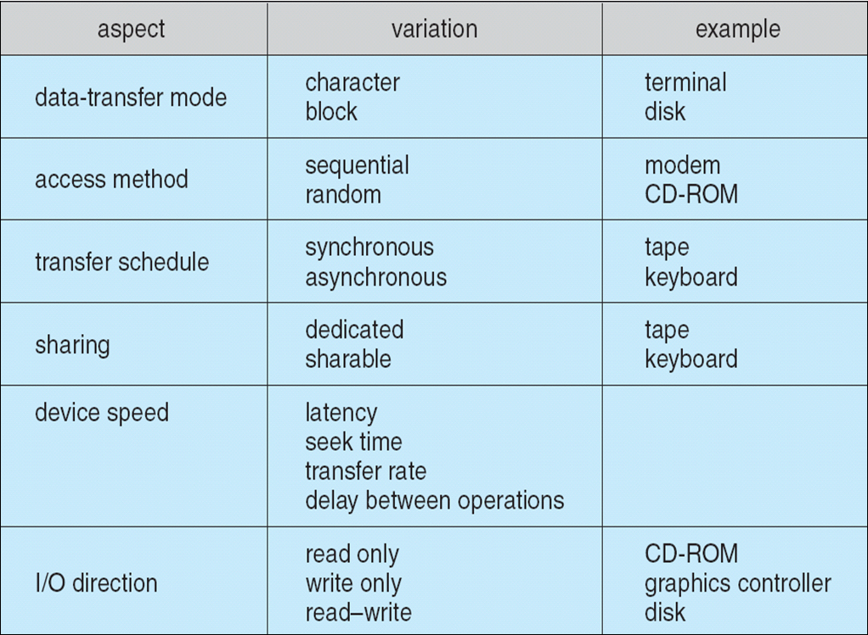
Characteristics of I/O Devices

Slide 35
Characteristics of I/O Devices (Cont.)
Subtleties of devices handled by device drivers
Broadly I/O devices can be grouped by the OS into
Block I/O
Character I/O (Stream)
Network sockets

Slide 36
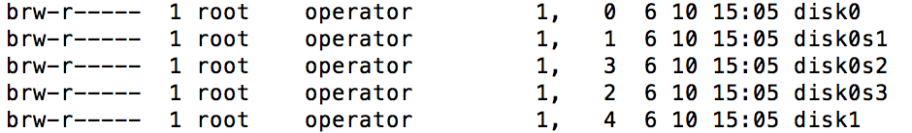
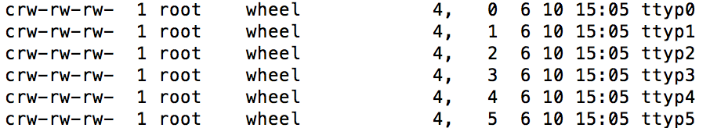
ls -l /dev

Slide 37
Block and Character Devices
Block devices include disk drives
Raw I/O
file-system access
random
Character devices include keyboards, mice, serial ports
Character stream
sequential

Slide 38
Application I/O Interface
Devices as files
open()
close()
read()
write()
seek()
Notes:
封装，抽象

Slide 39
UNIX I/O Kernel Structure

Slide 40
Kernel I/O Services

Slide 41
Kernel I/O Services
Scheduling
Buffering
Caching
Spooling
Protection

Slide 42
Scheduling
Scheduling
Some I/O request ordering via per-device queue
Some OSs try fairness
Disk scheduling

Slide 43
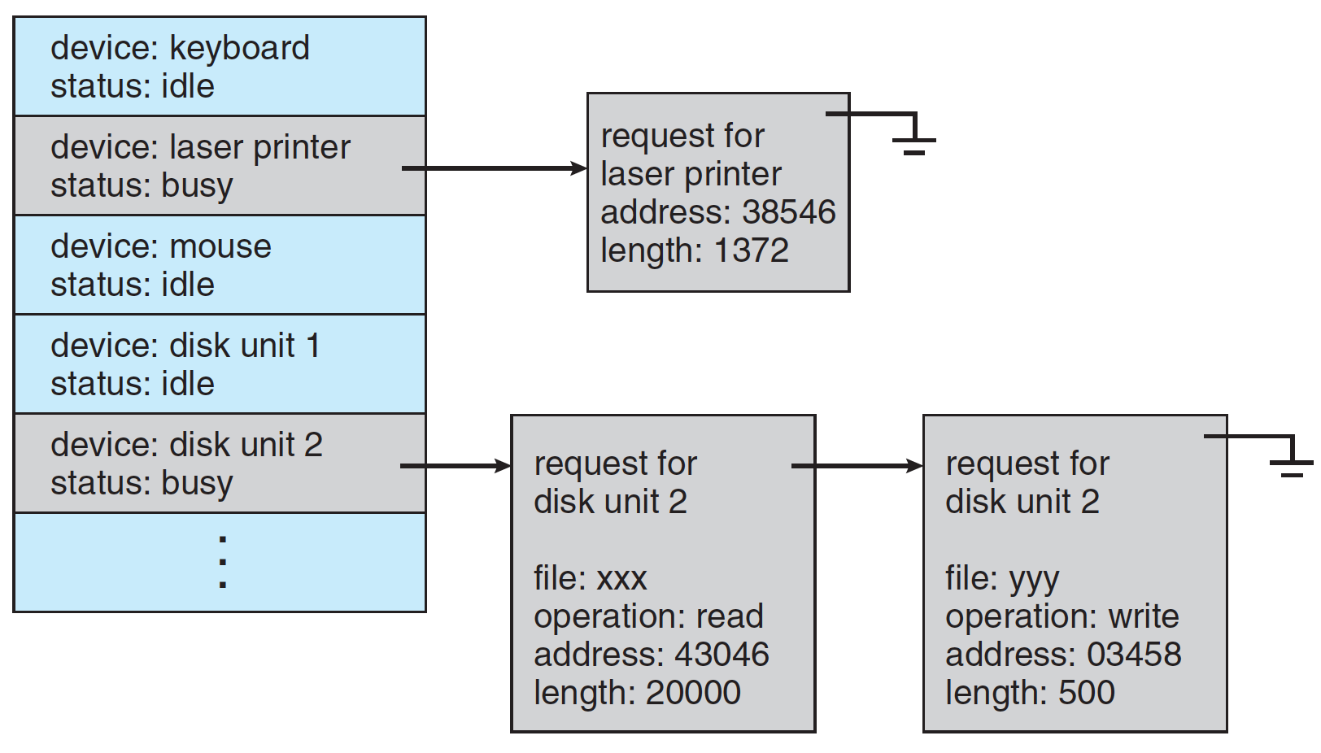
Device-Status Table

Slide 44
Buffering
Buffering - store data in memory while transferring between devices
To cope with device speed mismatch
To cope with device transfer size mismatch
Notes:
缓冲不到位
Speed vs size?

Slide 45
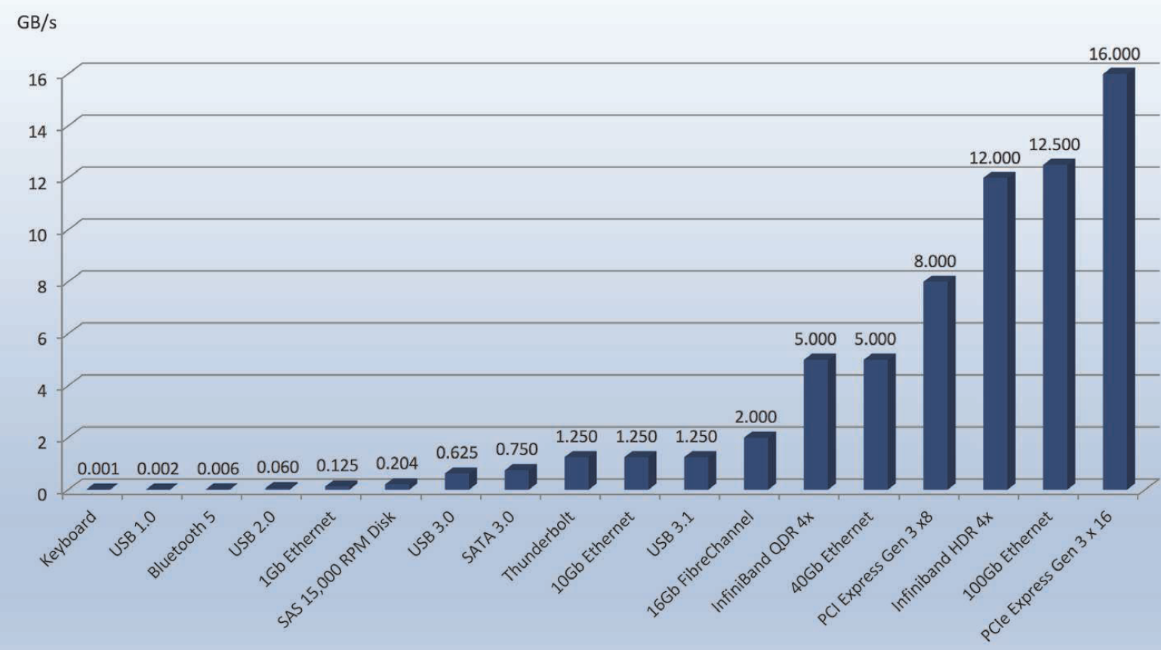
Device-Transfer Rates

Slide 46
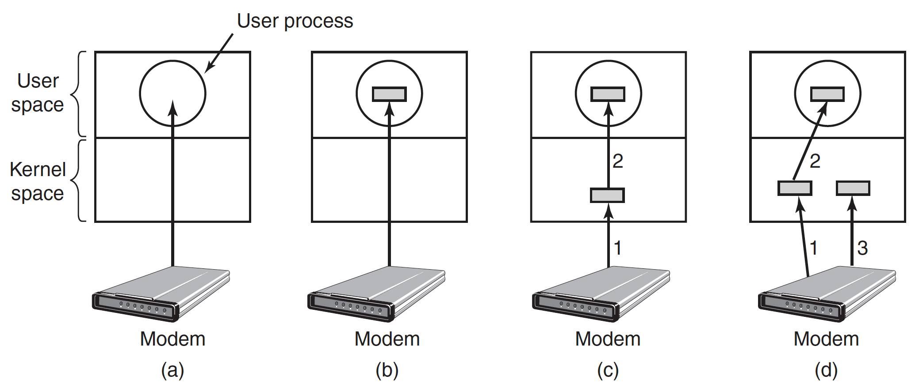
Buffering
Notes:
回顾一下Modern Operating System
Too many wake up
Swap out user space
Good,
Copy to user too slow

Slide 47
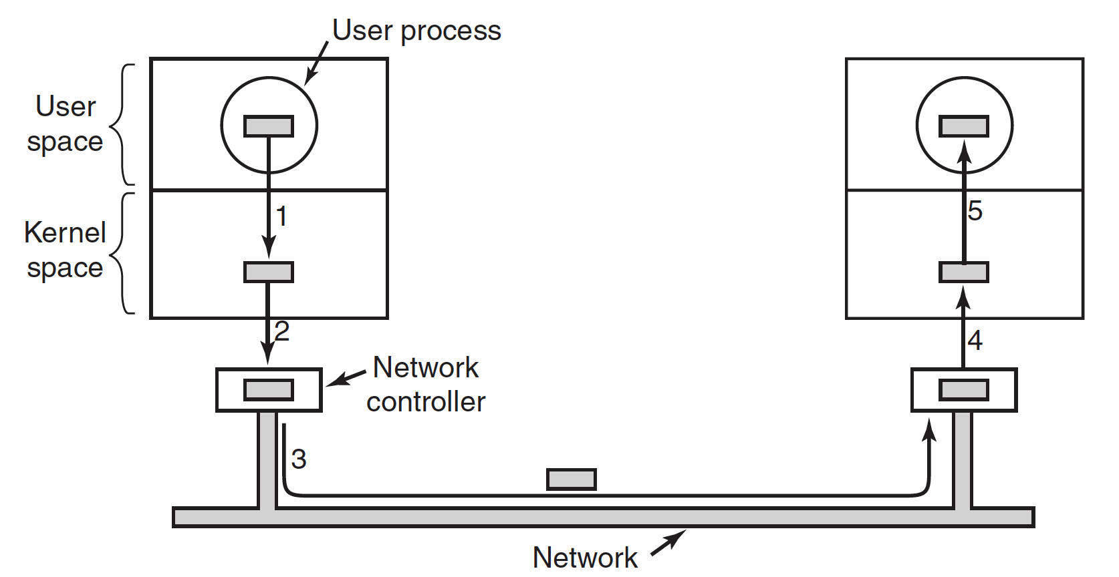
Buffering
Notes:
回顾一下Modern Operating System

Slide 48
Caching
Caching - faster device holding copy of data
Always just a copy
Key to performance
Buffer vs cache
Buffer: speed mismatch （缓冲，暂存）
Cache: 快取
Sometimes combined with buffering
Notes:
E.g. win7

Slide 49
Nonblocking and Asynchronous I/O
Blocking - process suspended until I/O completed
Non-blocking - I/O call returns as much as available
Synchronous: process waits
Asynchronous - process runs while I/O executes
read()
write()

Slide 50
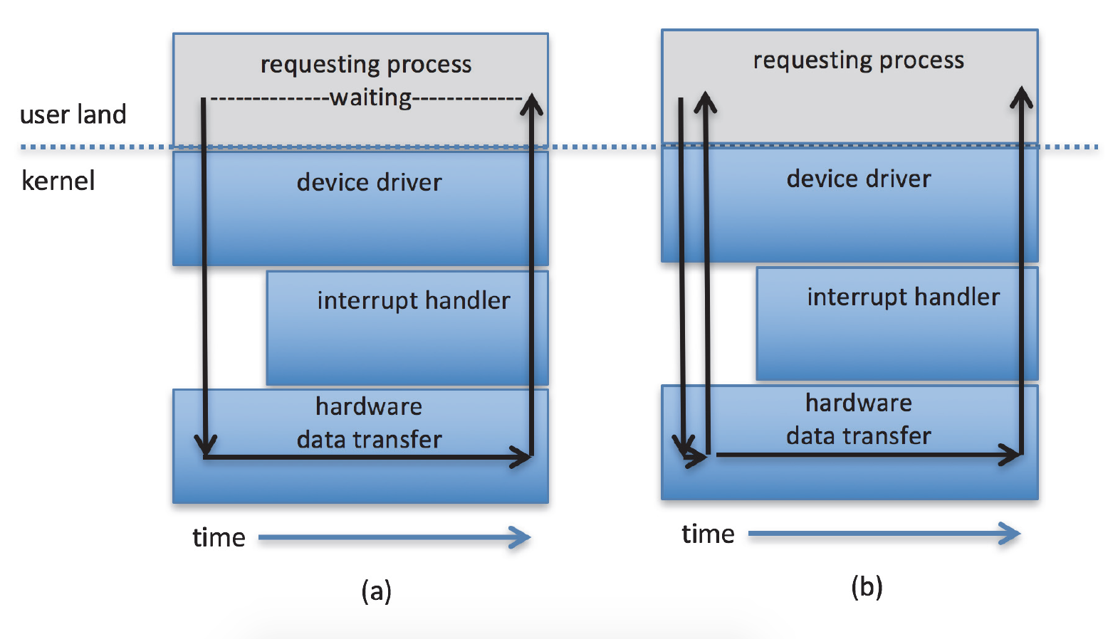
Two I/O Methods
Synchronous
Asynchronous

Slide 51
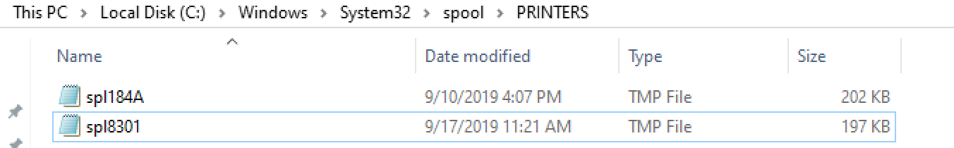
Spooling
Spooling - hold output for a device
simultaneous peripheral operations online
If device can serve only one request at a time
i.e., Printing (give an example, win7)
Notes:
C:\WINDOWS\System32\spool\PRINTERS

Slide 52
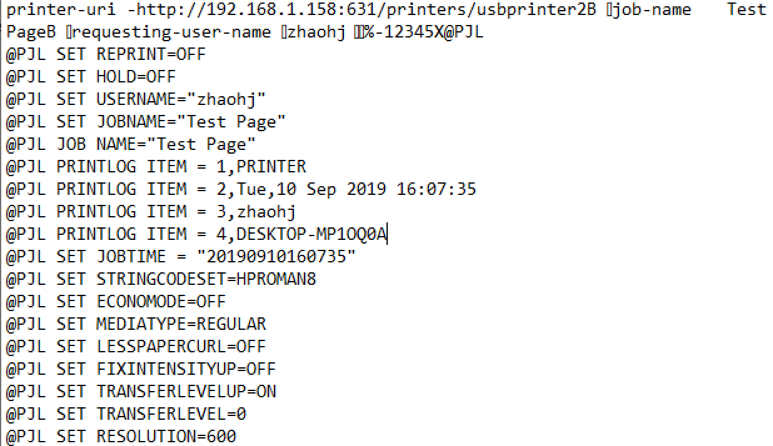
Spooling
Notes:
C:\WINDOWS\System32\spool\PRINTERS

Slide 53
A Whole Process

Slide 54
I/O Requests to Hardware Operations
Consider reading a file from disk for a process:
Determine device holding file
Translate name to device representation
Physically read data from disk into buffer
Make data available to requesting process
Return control to process

Slide 55
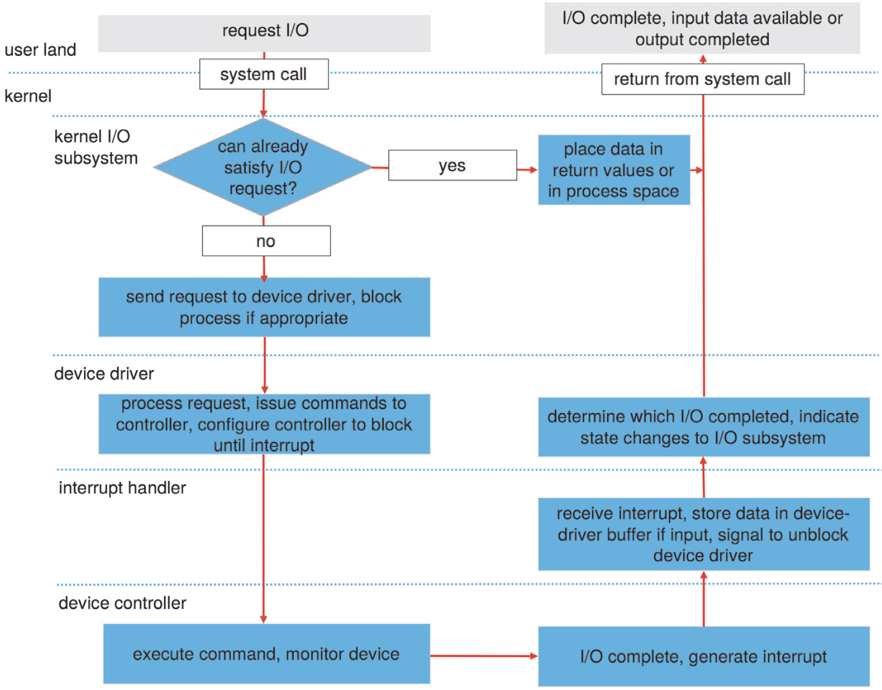
Life Cycle of An I/O Request

Slide 56
Life Cycle of An I/O Request
Notes:
Driver is blocked???

Slide 57
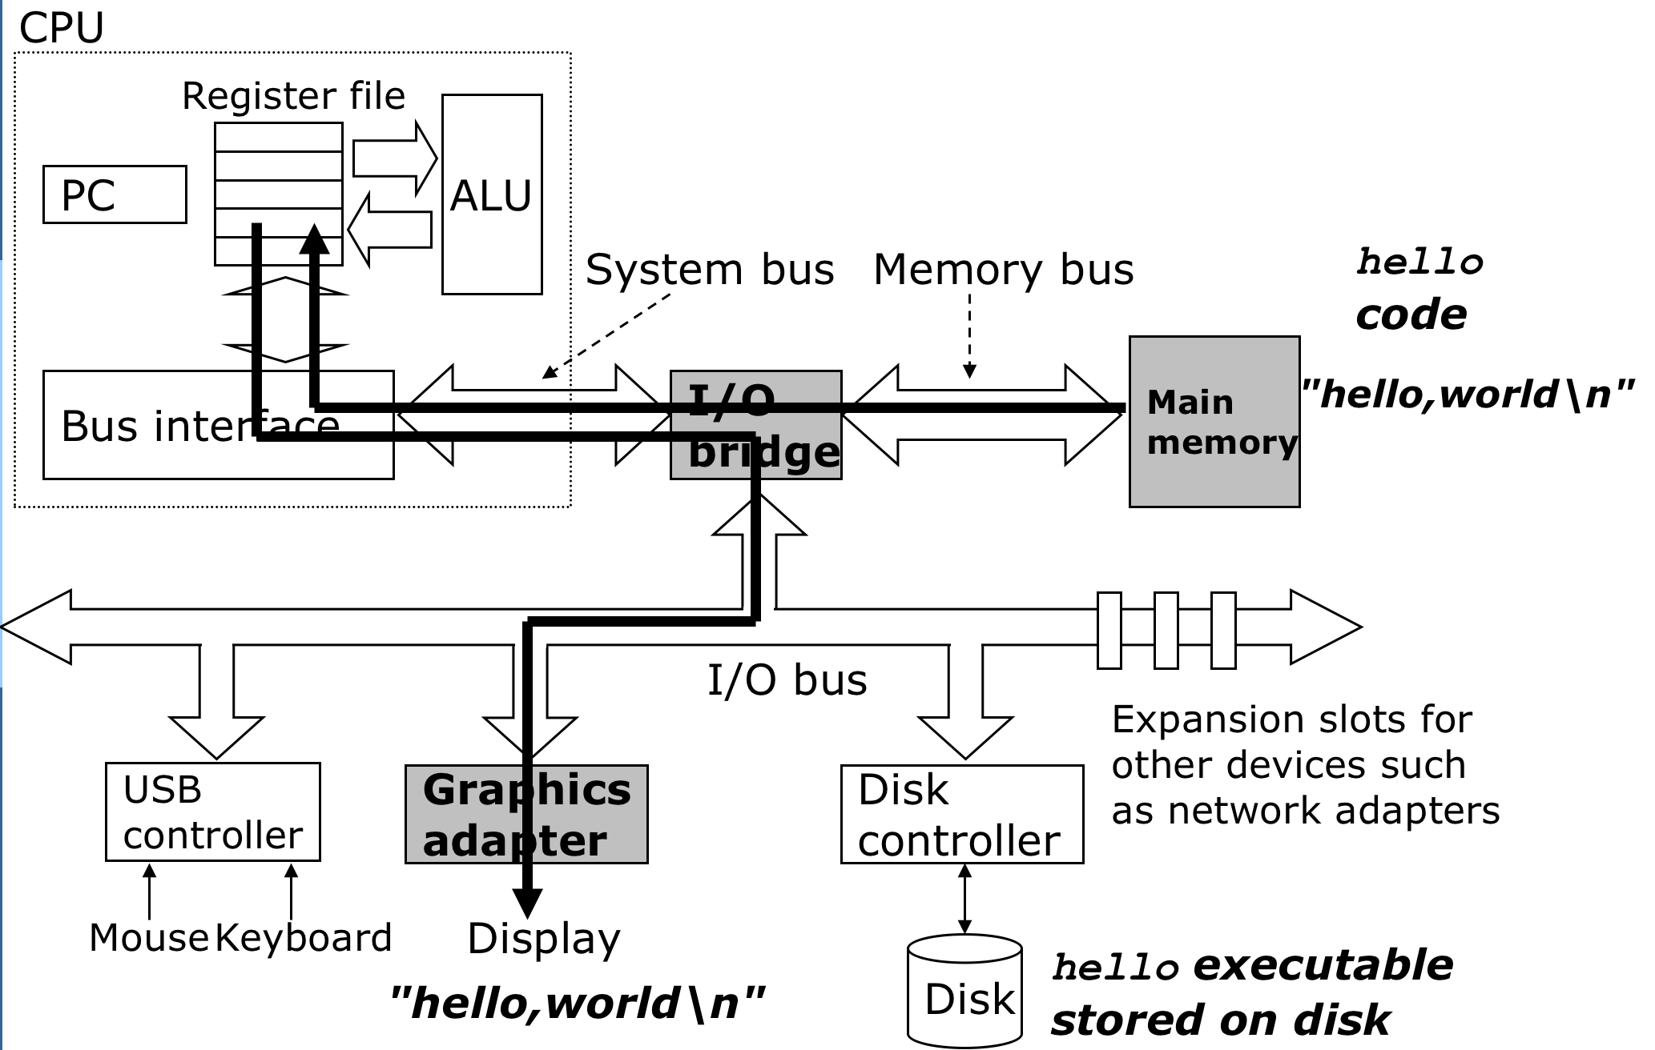
Terminal

Slide 58
printf(“%s”, str)
printf
write
driver
process str
stdout buffer
wait queue
display
hello world
hello world
hello world
hello world
User
Kernel

Slide 59
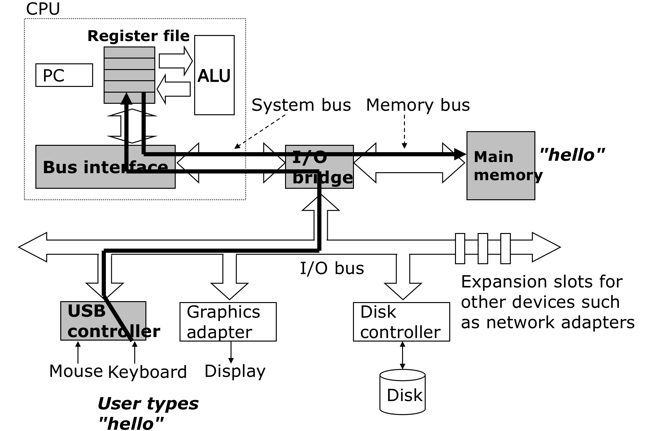
Keyboard

Slide 60
scanf(“%s”, str)
interrupt
read
scanf
keyboard
keyboard buffer
stdin buffer
process str
hello
hello
hello world
hello
Kernel
User

Slide 61
End of Chapter 13

